Slide 1
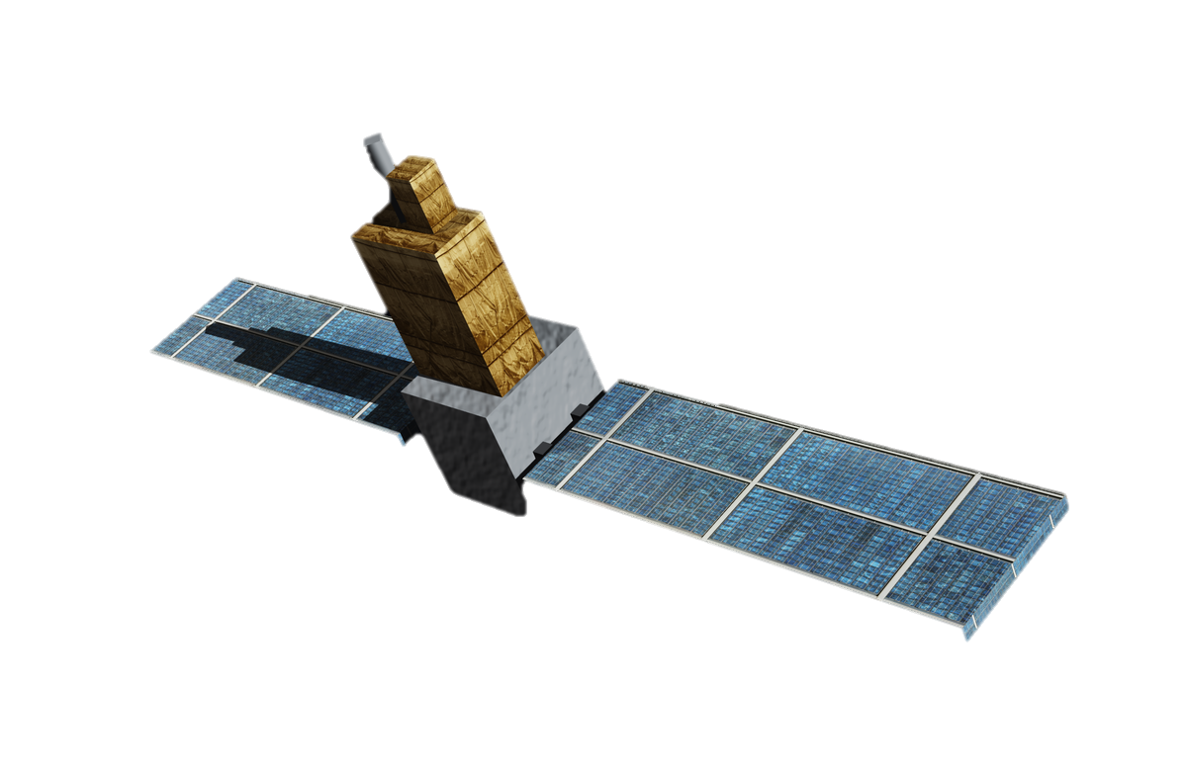
Space physic
Reporter: OU-YANG MIN WEI
Student number : 405290058

Slide 2
Contentst
FORMOSAT-1
FORMOSAT-3/COSMIC
Introduction to the plan
Characteristic
Data analysis
Introduction to the plan
Characteristic
Data analysis
4. Conclusion
5. Reference
Notes:
計畫介紹
衛星特性
數據分析
結論

Slide 3
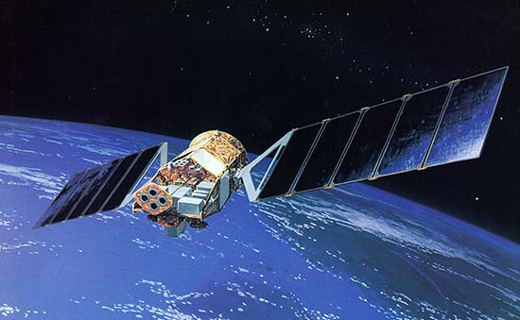
FORMOSAT-1 Introduction to the plan
Launched on January 27, 1999
Low-orbit scientific experimental satellite
main mission
Ionospheric effect measurement
Ocean color photography
Ka band communication experiment
The mission is two years, the design life is four years, and the actual operation is nearly five and a half years.
end mission in June 17, 2004.
Notes:
1999年1月27日發射升空
低軌道的科學實驗衛星
主要任務
電離層電動效應測量
海洋水色照相
Ka 頻段通訊實驗
任務壽命為二年，設計壽命為四年，實際運轉則近五年半
2004年6月17日，結束其任務

Slide 4
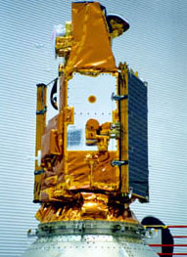
Characteristic
weight : 401 kg
orbit : 635 km, 35 degree tilt angle to the equator
One cycle: 96.7 minute
Design life: 4 years
Launch date: 1999/ 1/27
Retire : 2004/ 6/17
Notes:
重量 : 401 kg
軌道 : 635 km, 與赤道成35度傾斜角
繞行地球一周 : 96.7 minute
設計壽命 : 4年
發射日期 : 1999/ 1/27
功成身退 : 2004/ 6/17

Slide 5
Data analysis method
Using python and its model.
FORMOSAT-1
Satellite data for 2000 and 2001 years
Distribution of ions and O+
FORMOSAT-3/COSMIC
Satellite data for only 2007 year
Distribution of electron
Notes:
氧離子 與离子

Slide 6
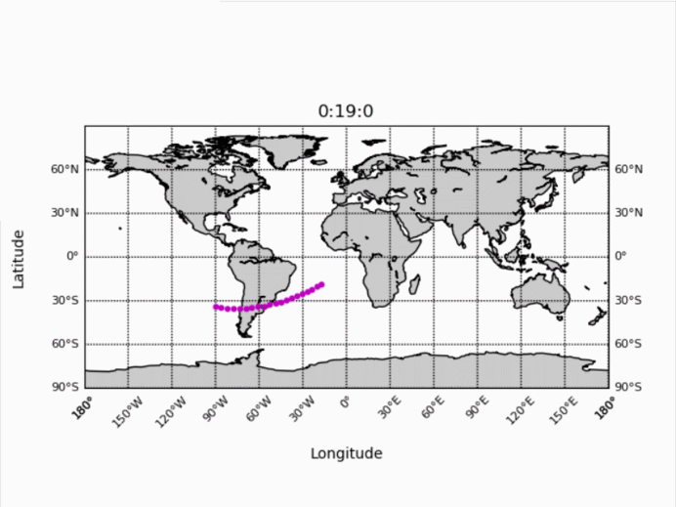
Orbit on the first day of 2000

Slide 7
Four seasons ion density distribution
Taking before and after 45 days
spring
summer
autumn
winter
3/21
6/21
9/21
12/21
DAY 36 ~ 127
DAY 128 ~ 219
DAY 220 ~ 311
DAY 311 ~ 366(leap year) + DAY 1~33

Slide 8
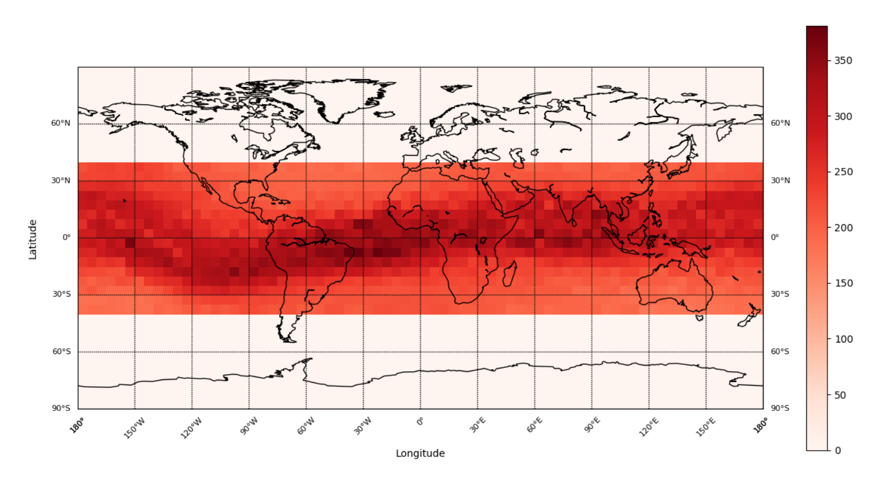
Distribution of ion density in spring 2000

Slide 9
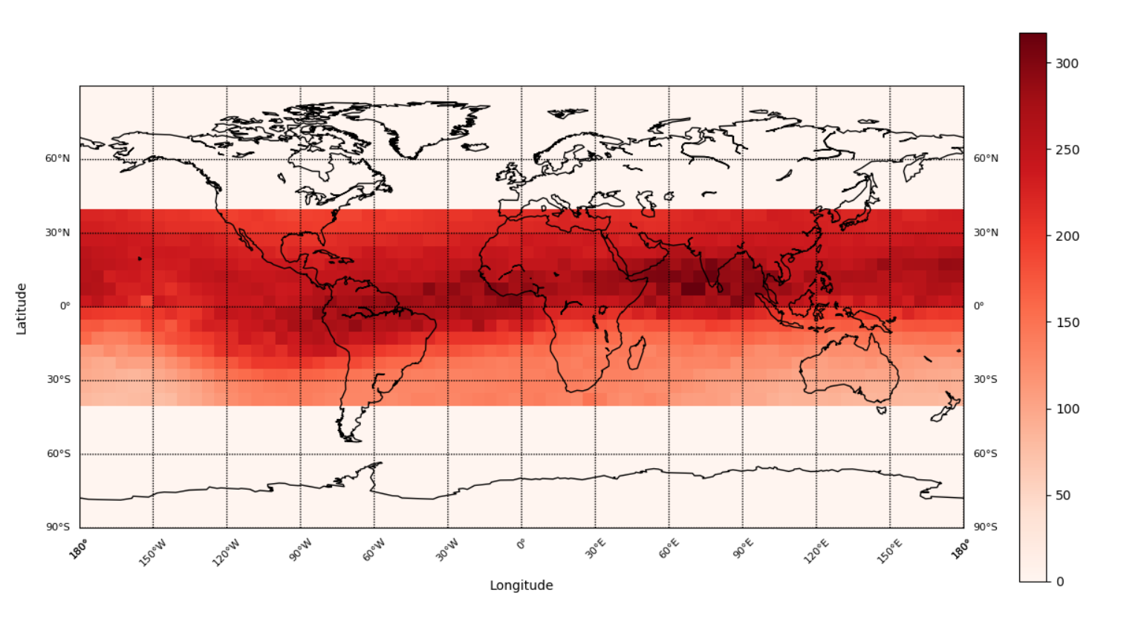
Distribution of ion density in summer 2000

Slide 10
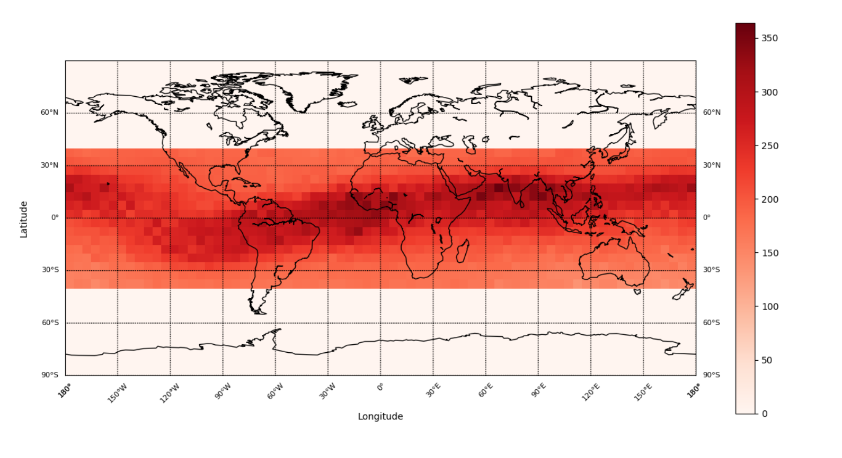
Distribution of ion density in autumn 2000

Slide 11
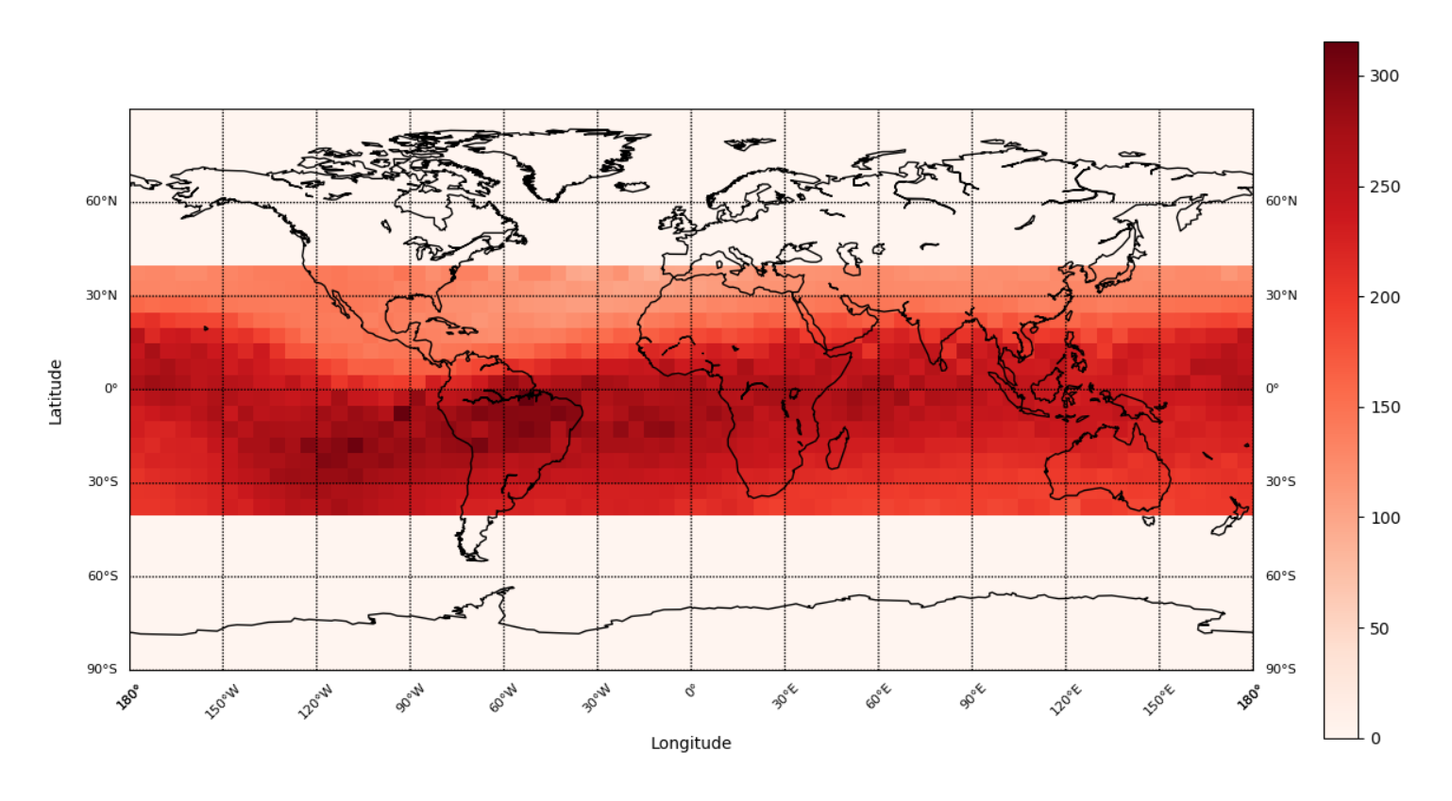
Distribution of ion density in winter 2000

Slide 12
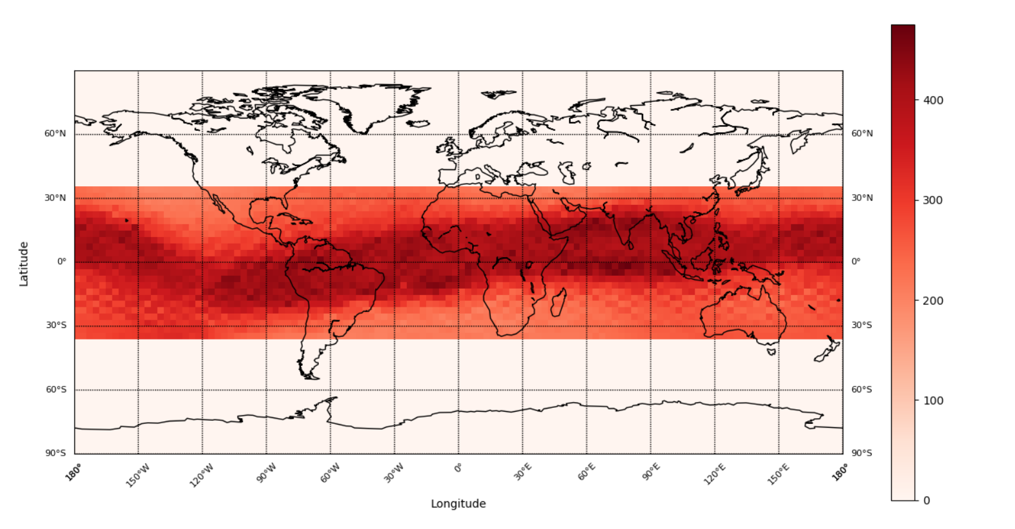
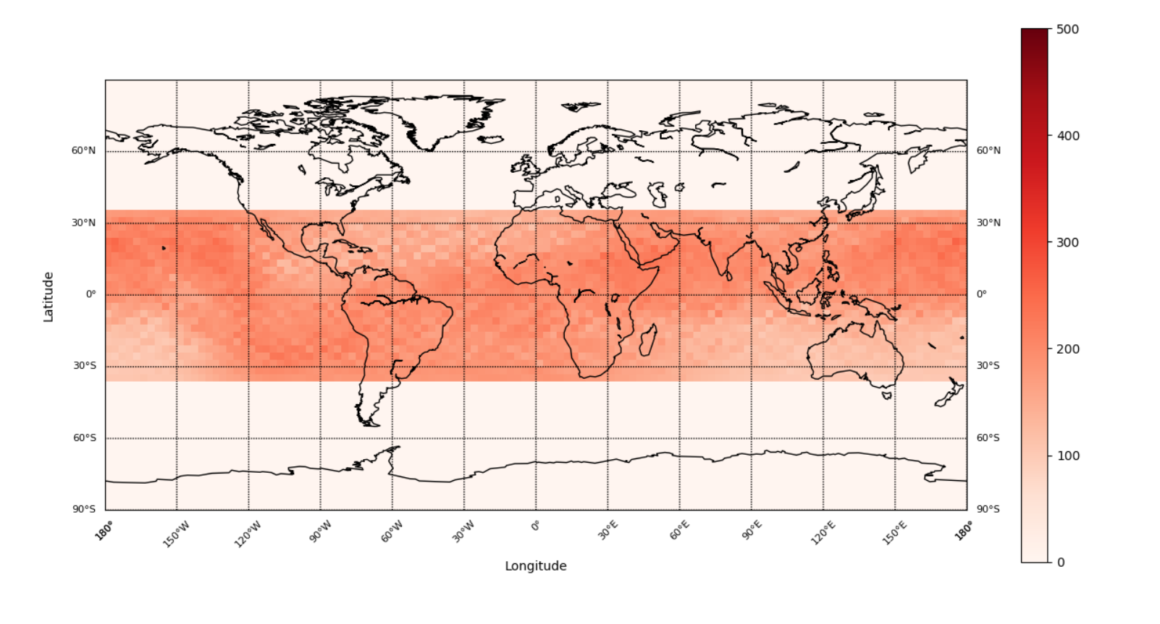
Day & night in 2000
noon (11 12 13)
Early morning (23 0 1)

Slide 13
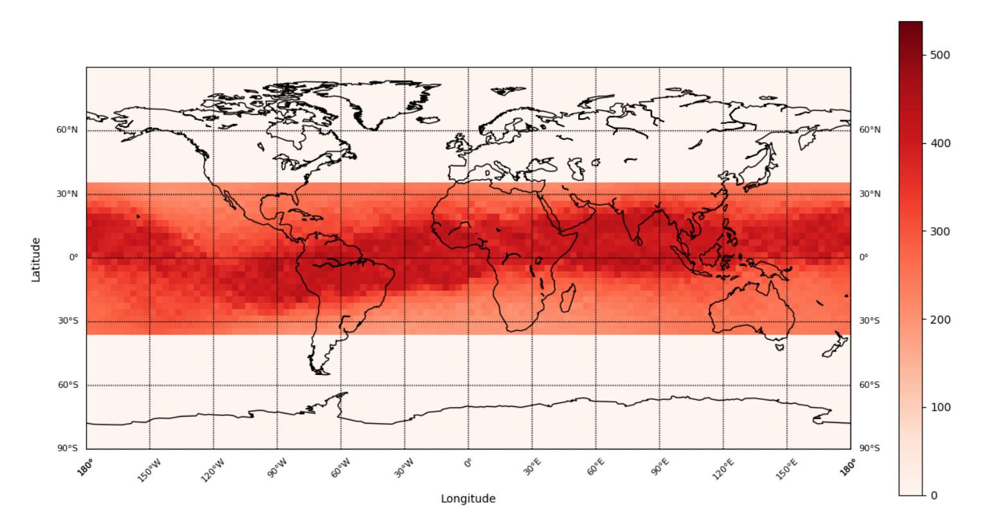
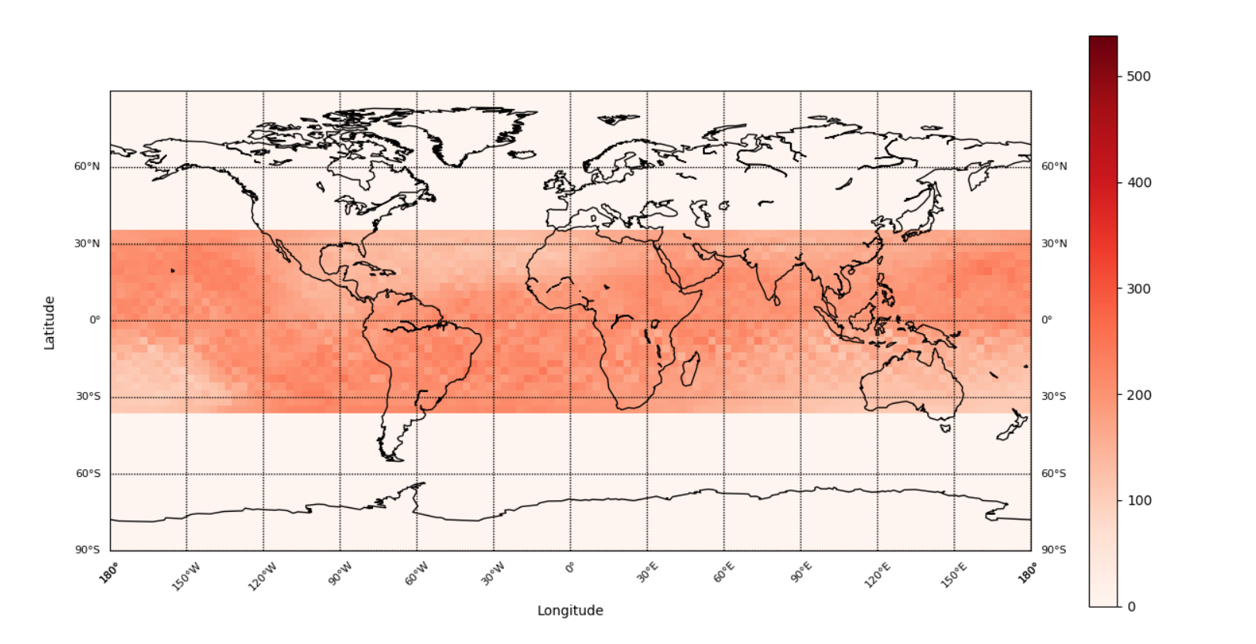
Day & night in 2001
noon (11 12 13)
Early morning (23 0 1)

Slide 14
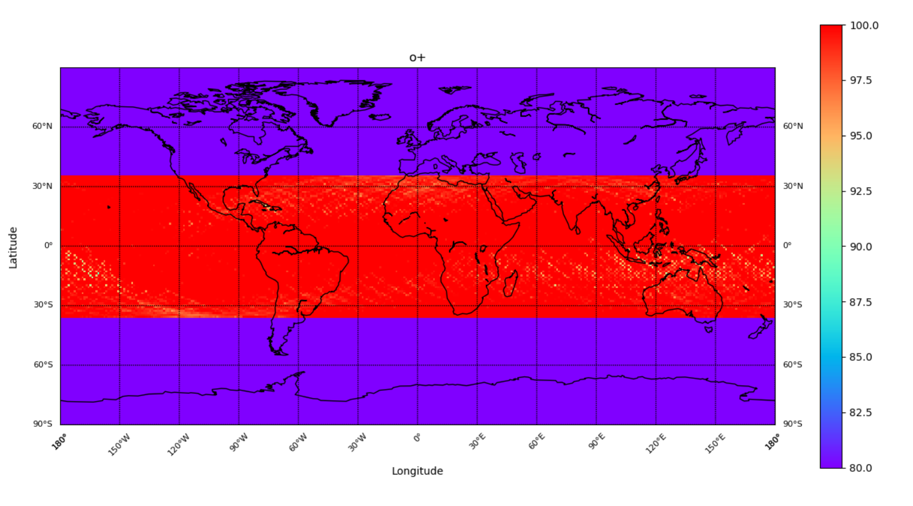
Distribution of O+ density in spring 2000

Slide 15
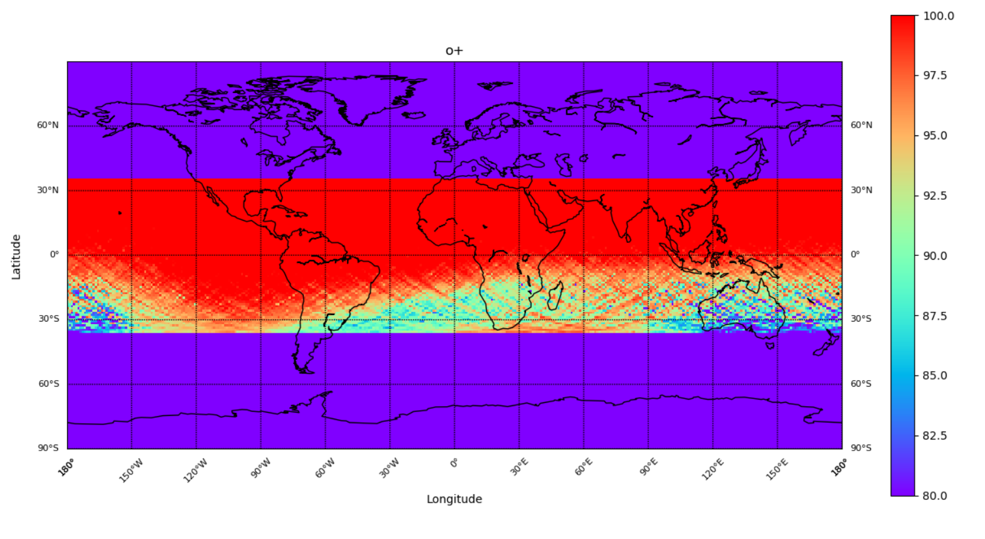
Distribution of O+ density in summer 2000

Slide 16
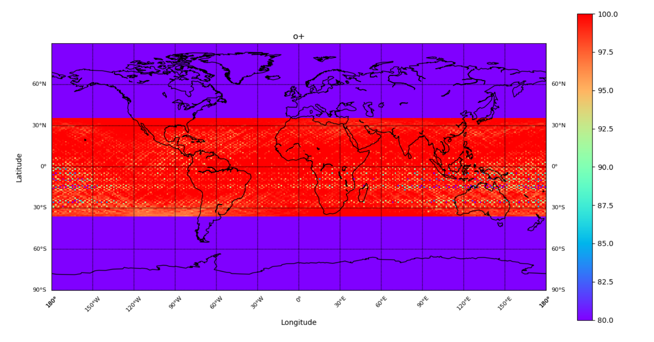
Distribution of O+ density in autumn 2000

Slide 17
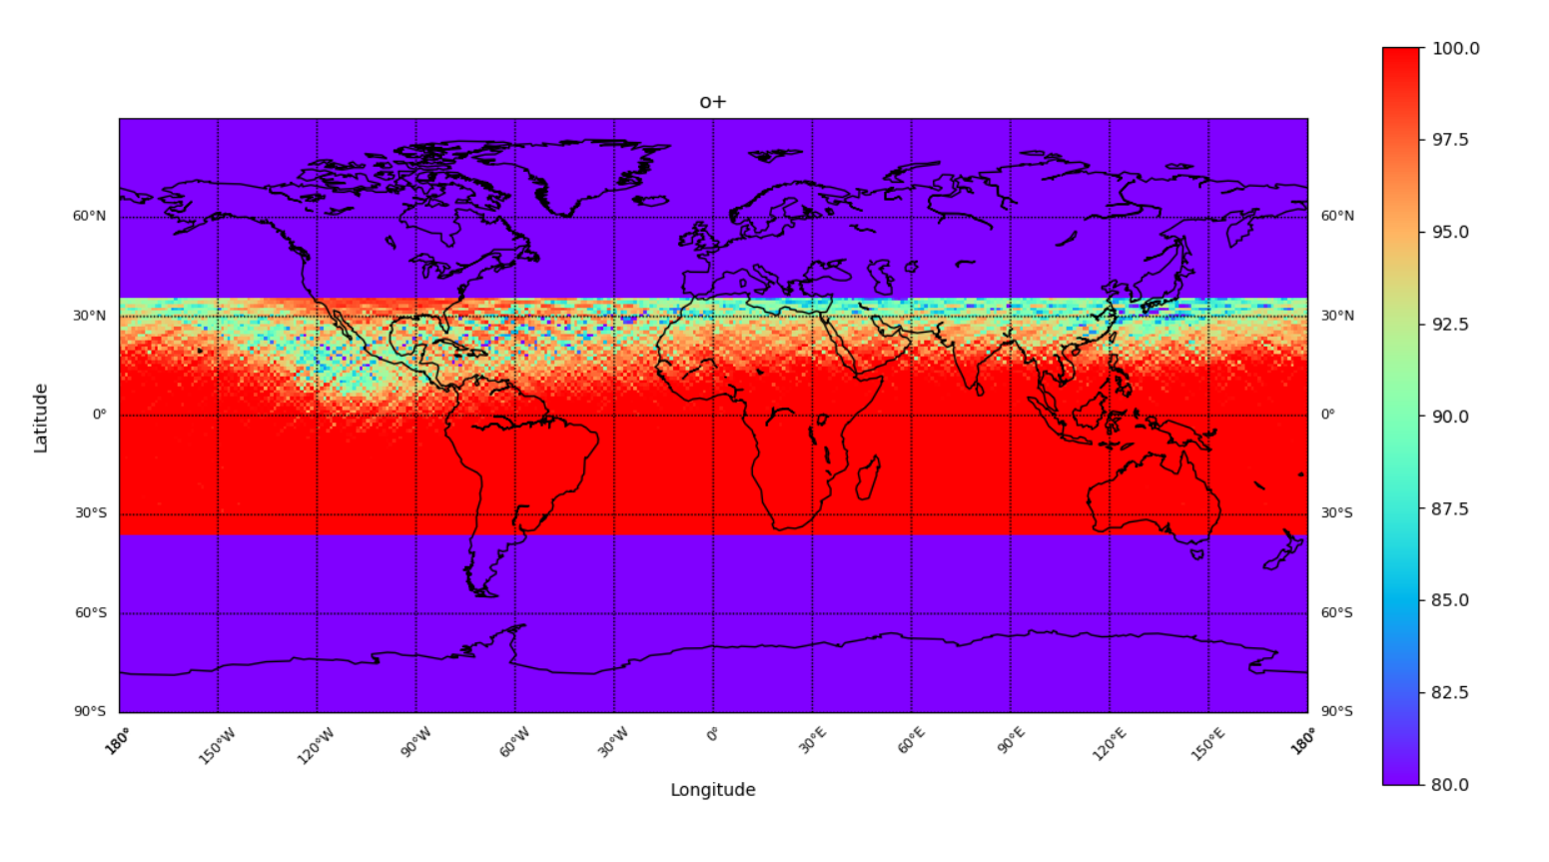
Distribution of O+ density in winter 2000

Slide 18
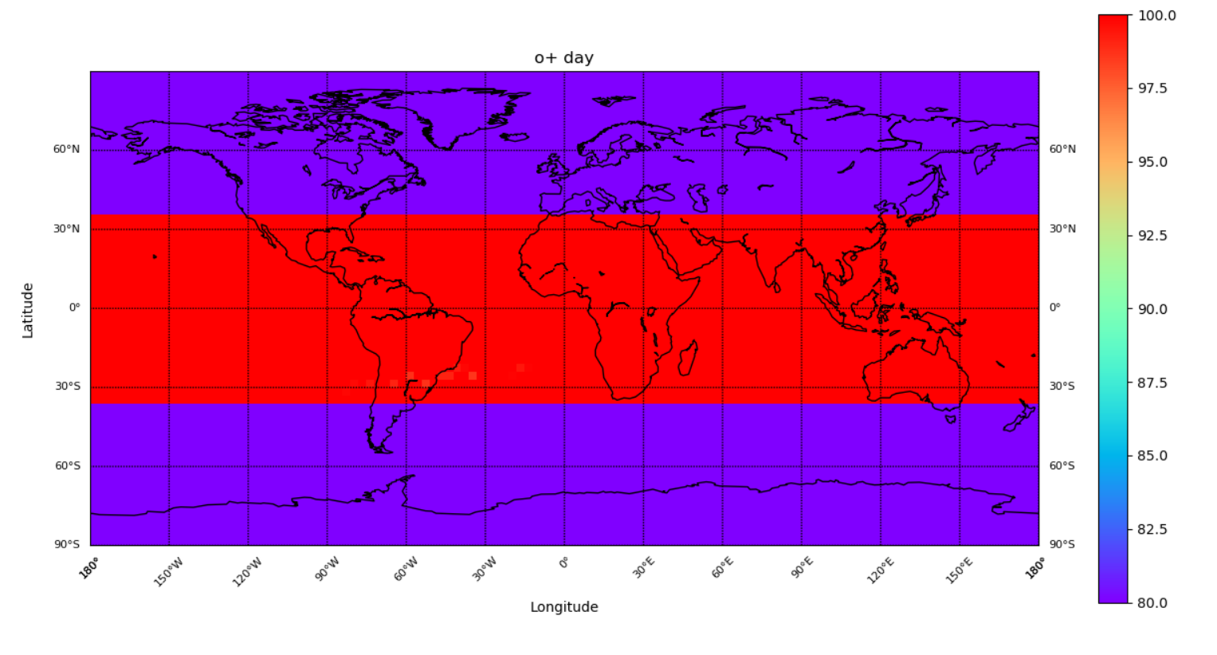
In 2000 morning

Slide 19
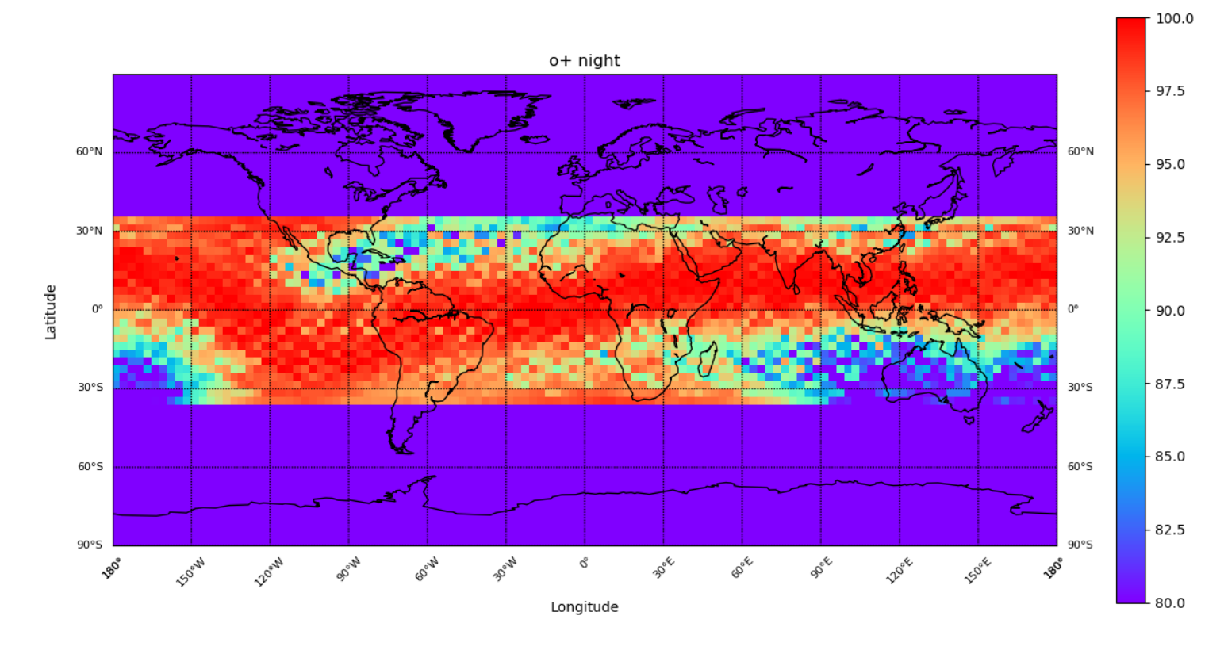
In 2000 night

Slide 20
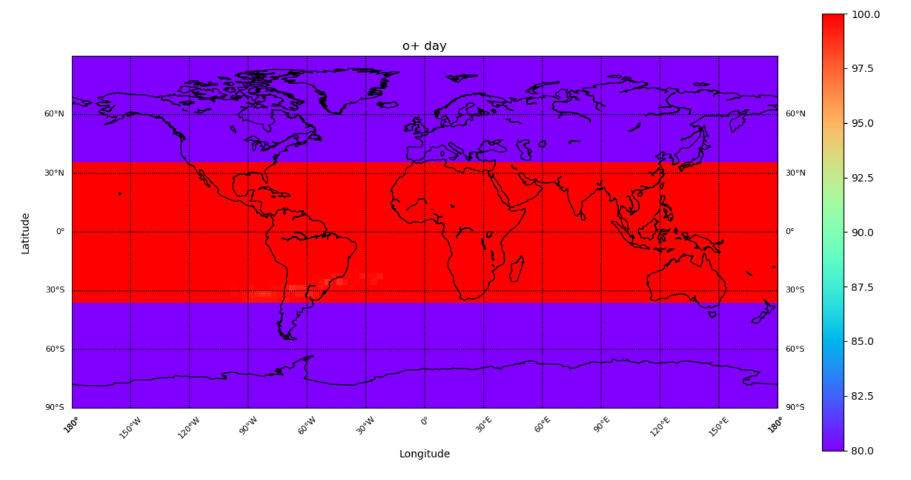
In 2001 morning

Slide 21
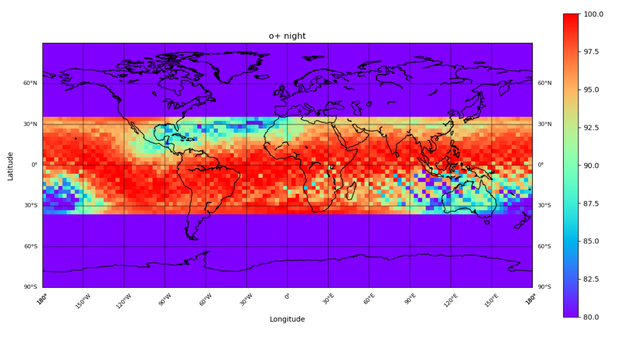
In 2001 night

Slide 22
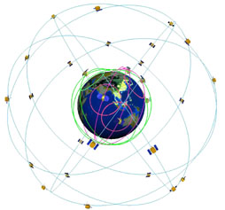
FORMOSAT-3/COSMIC Introduction to the plan
NSPO and UCAR cooperate to execute
Consists of six microsatellites
Launched on April 15, 2006
Main mission
Research on the phenomenon of climate change
Ionospheric dynamic monitoring
Global space weather forecast
Earth gravity research
Notes:
國家太空中心(National Space Organization, 簡稱NSPO)
美國大學大氣研究聯盟(University Corporation for Atmospheric Research, 簡稱UCAR)
共同執行合作
一次發射六顆微衛星，分佈於地球表面 700~800 公里高
氣候變遷現象之研究
電離層動態監測
全球太空天氣之預報
地球重力研究

Slide 23
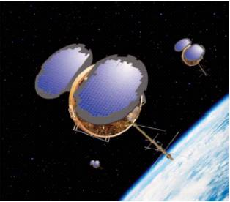
Characteristic
Consists of six microsatellites
weight : One about 62 kg
orbit : Round orbit, angle 72 °
height : 700 ~ 800 (km)
One cycle：100 minute
Design life: 5 years
now : Two satellites still in operation
Notes:
由六顆微衛星組成一個星系
重量 : 一顆約62公斤
軌道 : 圓形軌道，頃角72度
高度 : 700 ~ 800 (km)
繞行一周：100 minute
設計壽命 : 5年以上
現今 : 尚餘兩顆衛星還在運作

Slide 24
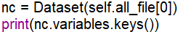
data analysis
高度
緯度
經度
離子密度

Slide 25
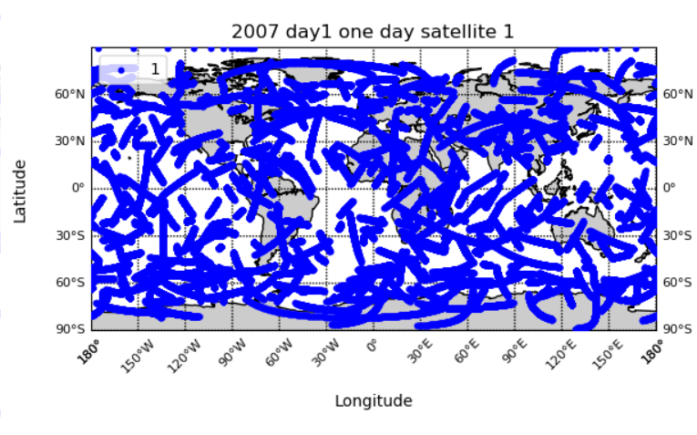
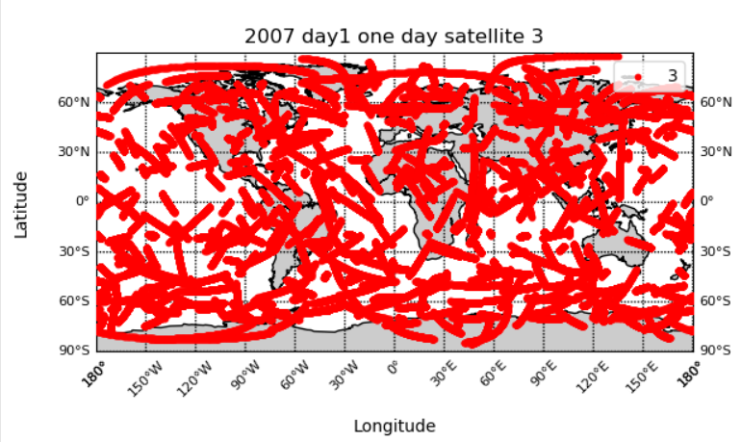
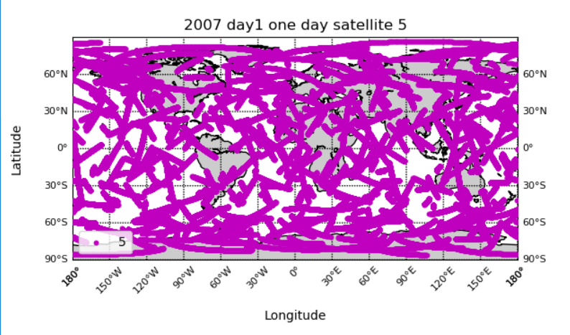
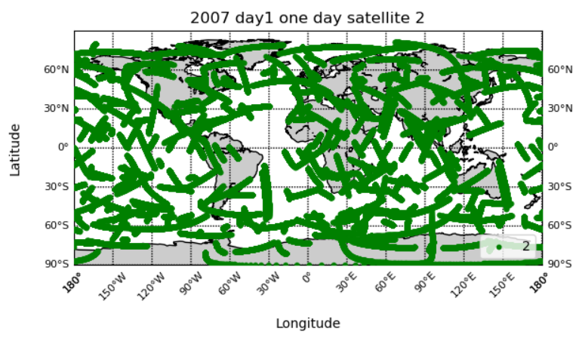
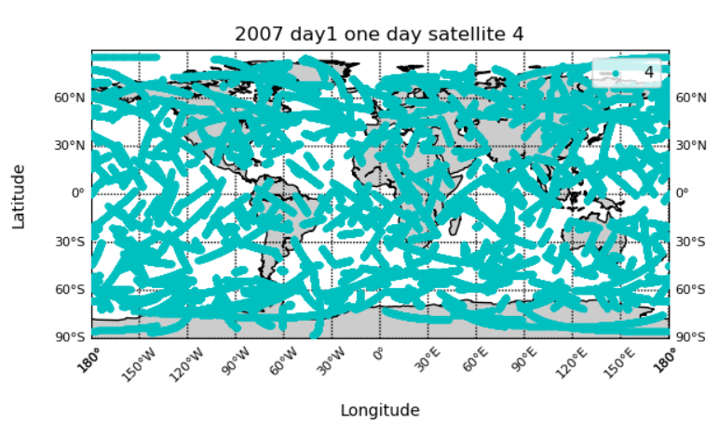
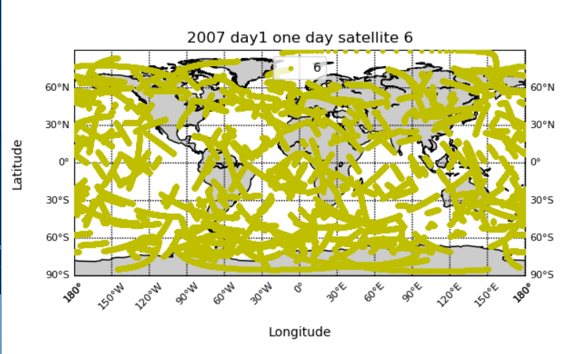
6 satellites distributed in a day
Notes:
6顆衛星一天分布

Slide 26
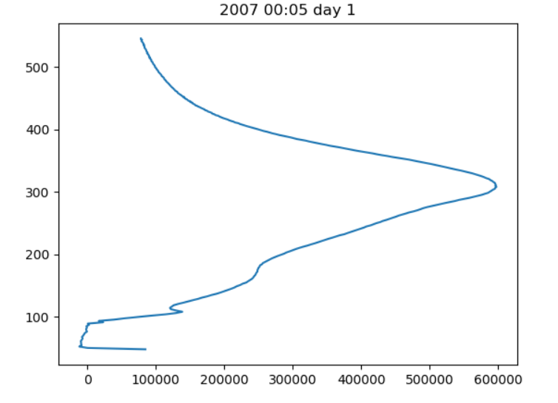
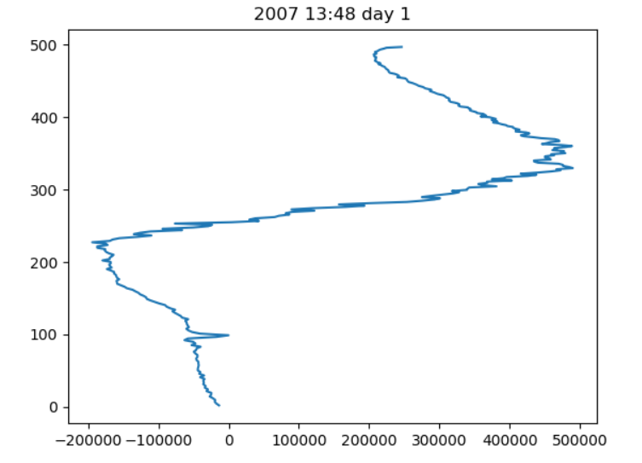
High against ion density

Slide 27
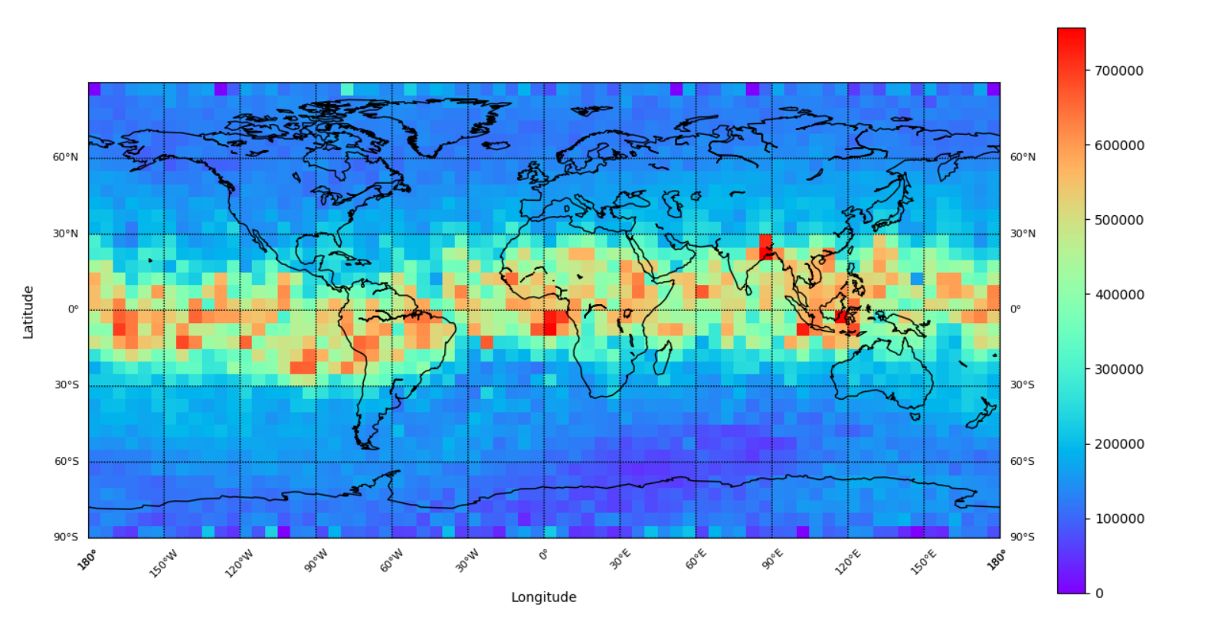
Distribution of electron density in spring 2007

Slide 28
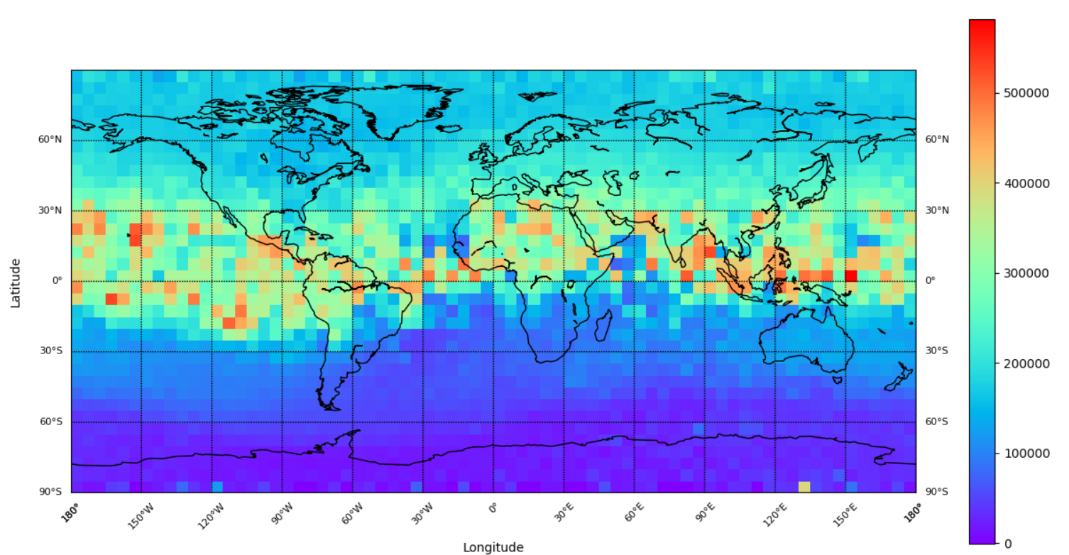
Distribution of electron density in summer 2007

Slide 29
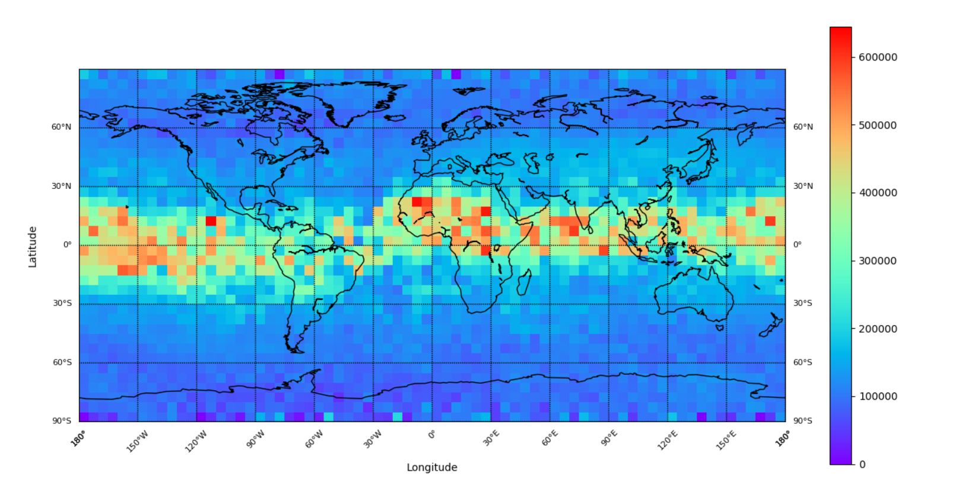
Distribution of electron density in autumn 2007

Slide 30
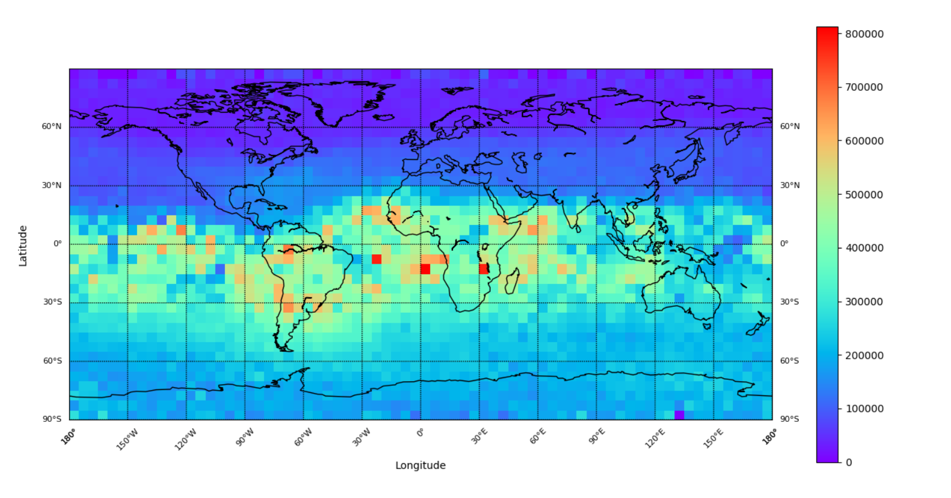
Distribution of electron density in winter 2007
Time spent

Slide 31
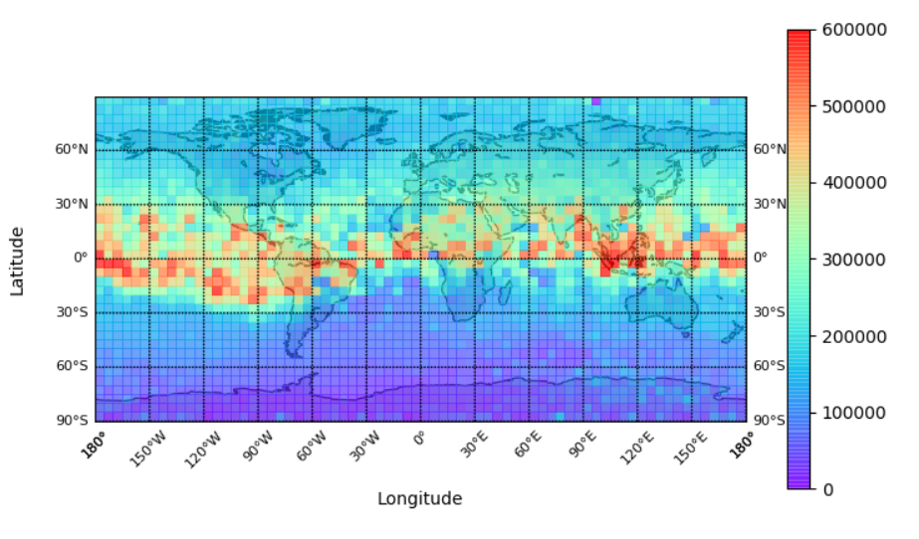
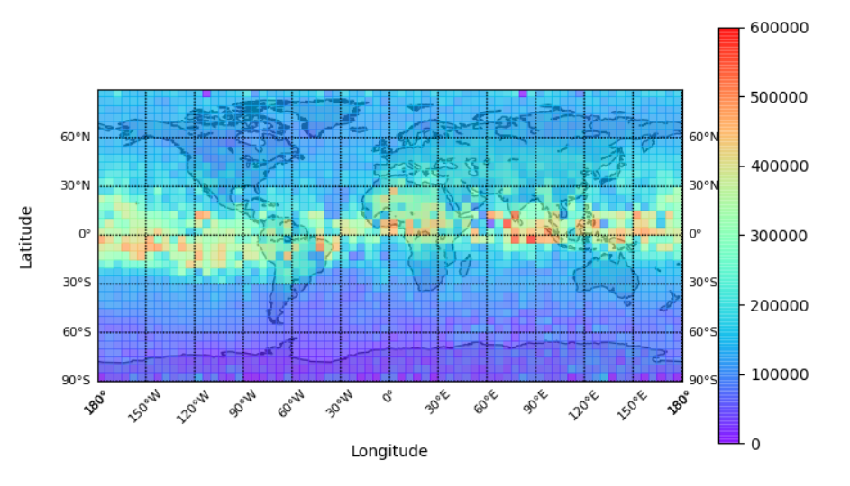
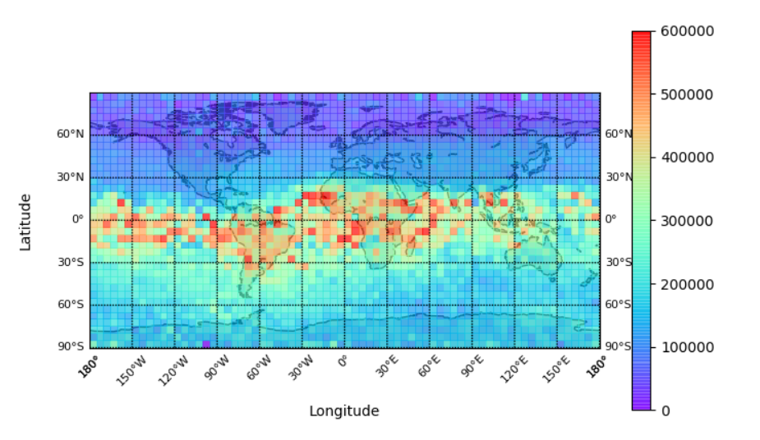
Conclusion
summer
We can through these result, the sunlight will affect the electron and the ion distribution.
winter

Slide 32
Reference
https://www.nspo.narl.org.tw/tw2015/projects/FORMOSAT-3/program-description.html

